Slide 1
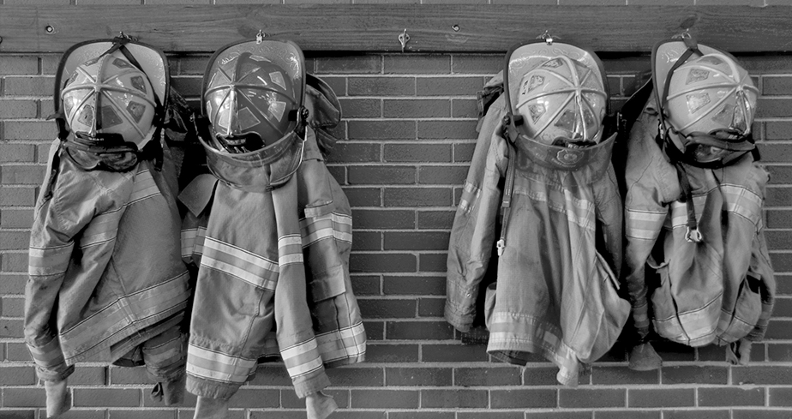




Slide 2
CONTACT INFORMATION
Your instructor is your primary
point of contact.
If unavailable, contact:
On-Campus/DOD: Training Division: training@alabamafirecollege.org.
Off-Campus: Regional Coordinator

Slide 3
FACILITIES / EMERGENCY PROCEDURES
Instructor will provide information on the facilities at your class location: restrooms, vending, and tobacco-use areas.
In the event of an emergency, your instructor/proctor will provide you with guidance/instructions.

Slide 4
PAPERWORK
Honor Statement: Must be completed prior to class.
Prerequisites: The Alabama Fire College has made every attempt to ensure students are aware of all prerequisites for certification testing.
Felony Conviction Statement: You must attest that you have not been convicted of a felony in order to receive certification.
Photo Release

Slide 5
HEALTH INFORMATION FORM
The information you provide is intended for medical use only. Your medical information is privileged and for the use of the medical staff of the health care facility you might be referred to for any acute care.
*Must have a Yes or No check in each box and must be signed and witnessed.
Notes:
These forms stay with the course coordinator/lead instructor in field-delivery classes.

Slide 6

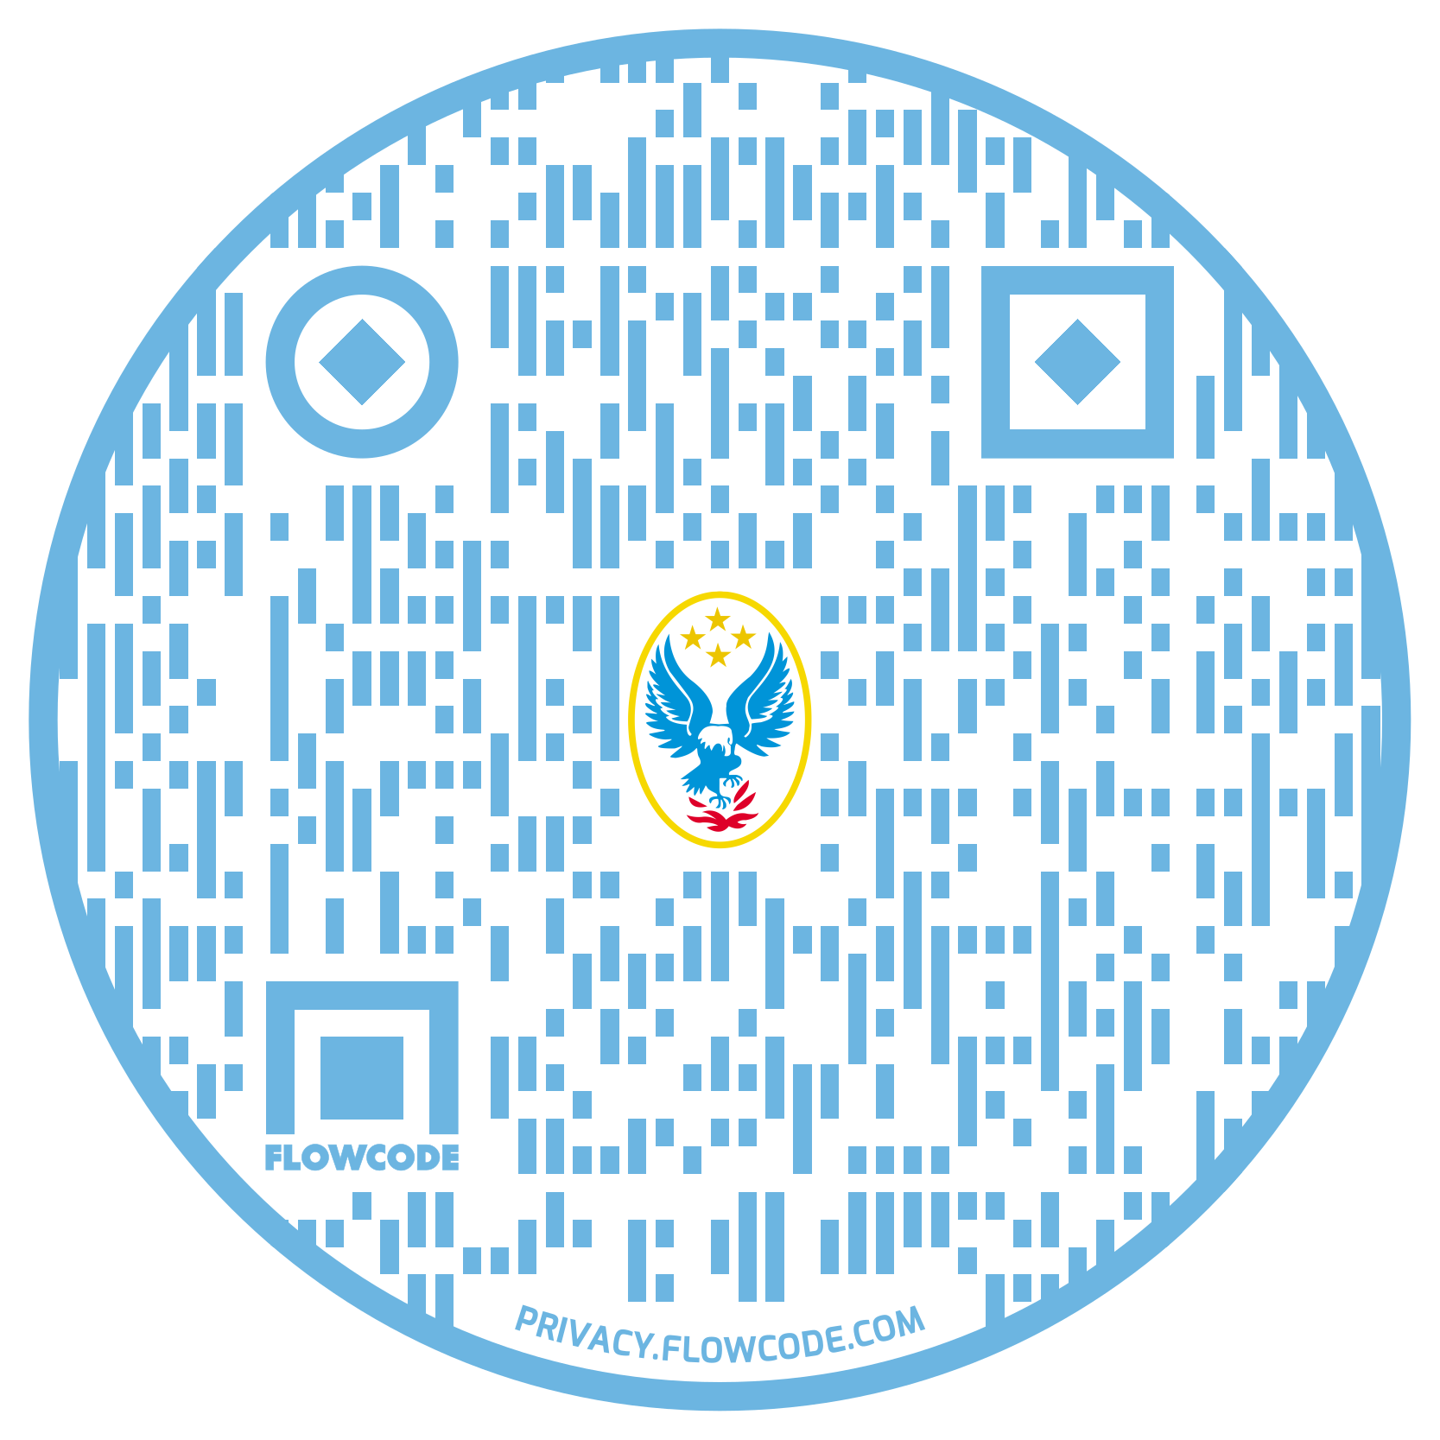
NFA COURSE CREDIT
Require a FEMA SID: https://cdp.dhs.gov/femasid
Select “Need a FEMA SID?
Course Codes (Box 12A):
Officer I Y201
Officer II Y202
Instructor I Y101
Instructor II Y102
AO Pumper Y655
AO Aerial Y654
Inspector I Y705
Inspector II Y706
Public Fire & Life Safety Educator I/II Y552
Use your phone’s camera to access the FEMA SID website using the QR code above!
Notes:
Students should keep the NFA form and turn it into the instructor at the end of class.

Slide 7

QUESTIONS?

Slide 8
TESTING & CERTIFICATION
Certification testing will occur on last day of class, administered by a Certification Proctor, and may include a written test and a skills test (projects may be included).
Results: Please allow 14 business days for test results. Results will be sent in email form, (check your spam folder as well). If no response in 14 business days, please do not call; contact us by email at certification@alabamafirecollege.org.
Certification criteria & skills packages are available on our website.
Notes:
Testing information cannot be released over the phone.
Verify that your email address is correct.
DOD email addresses may not be accessible, please use a personal email address.

Slide 9
WHAT IS CERTIFICATION?
The issuance of a certificate to acknowledge that an individual has acquired the skills and knowledge necessary is to meet a particular standard of professional competency for fire service personnel.

Slide 10



WHAT IS ACCREDITATION?
Accreditation serves as an affirmation that the certification processes of the Alabama Fire College meet the standards of excellence as defined by the national accrediting body.

Slide 11
WHY IS ACCREDITATION
SO IMPORTANT?
Affirms that the candidate has been through a program that has been validated by a third-party accrediting body.
Opens mobility opportunities to candidate.
Increases job marketability.
Increases promotional opportunities.
Improves safety and health for firefighters and citizens they serve.

Slide 12
ACCREDITATION CRITERIA
(REQUIRED OF THE AFC)
Testing procedures must uniformly and consistently measure the performance of candidates to those skills, abilities, and knowledge in the job performance requirement, requisite knowledge, and requisite skill of the applicable professional standard.

Slide 13
PROJECT-BASED COURSES
ProBoard and IFSAC require students meet the minimum qualifications identified in the NFPA standard.
Projects are considered part of skills testing. The projects assigned during your course are what we use to meet the NFPA standard and are required to receive a certificate from these accrediting bodies.

Slide 14
SKILLS TESTING PROCEDURES
Candidates will be tested utilizing the current skill sheet packages.
Candidate will be oriented to the testing area layout.
Candidates will be directed when to enter testing area.
Candidate may be tested individually on a skill, tested individually within a team, or both depending on the skills that were randomly drawn for this skills testing.

Slide 15
SAFETY PROCEDURES
Appropriate PPE shall be worn while training and during testing.
Evolutions may be halted during training or testing if an unsafe situation arises.
Student will not be penalized for safety concerns.

Slide 16
SKILLS TESTING
Each candidate will be given an initial attempt at each skill.
Evaluators will not indicate if the candidate has passed or failed.
When all skills are completed the candidates will be instructed to leave the testing area.

Slide 17
SKILLS TEST SECURITY
Individual: Candidates are not to observe other candidates performing individual skills testing. This is considered cheating.
Team: You are to communicate during any team skill as you normally would to complete the JPR. Candidates are to complete their portion of the team skill. Candidates are not allowed to correct or assist others with a portion of the team skill that is not assigned to them.

Slide 18
RETEST
Retests will be conducted only after all candidates have completed their initial testing.
If a candidate fails his/her portion of a team skill, only that candidate will be retested.
Other candidates may provide support for a retest; only the candidate who is retesting will be evaluated.
Retests will be scored by a different evaluator.
Failure of a retest will require the candidate to retest at a different testing site after a 30 day waiting period.

Slide 19
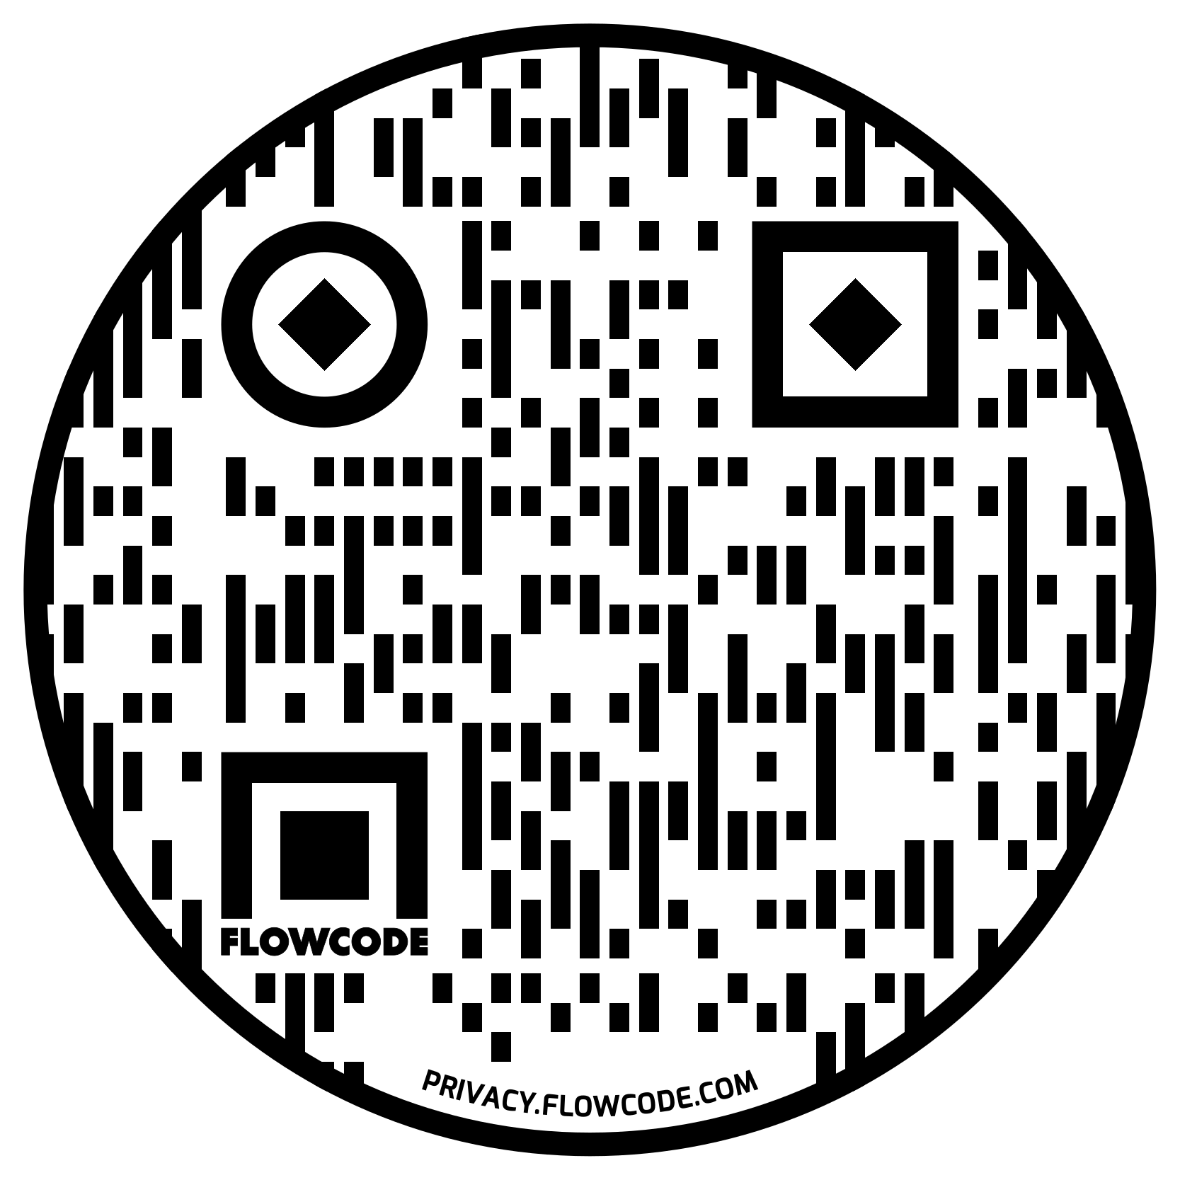
VISIT US ONLINE!
Hold your phone’s camera in front of the QR Code to access our social media links.
www.alabamafirecollege.org
1(800)241-2467
www.afcbookstore.com
1(866)984-3545

Slide 20
QUESTIONS?

